Slide 1
ELET2405
DIGITAL CLOCK PROJECT
By Abegail T. McCalla (620157646)

Slide 2
Objectives
To Introduce my digital clock.
To discuss the software components of my digital clock.
To discuss the hardware components of my digital clock.
To discuss why my digital clock is a cut above the rest.
To discuss the challenges faced while developing my digital clock.

Slide 3
Introduction
Humans have long sought a means to precisely measure and keep track of time ever since it was discovered.
Einstein's contributions significantly impacted our comprehension of clocks, time measurement, and their connection to the fundamental principles of the universe.
Unlike conventional analog clocks, which indicate time with hour and minute hands, digital clocks display the time in a numerical manner using digits.
Digital clocks give a clear and easy-to-read depiction of the time. The majority of digital clocks are microcontroller-based, which makes them more compact, effective, and functionally versatile than earlier models.

Slide 4
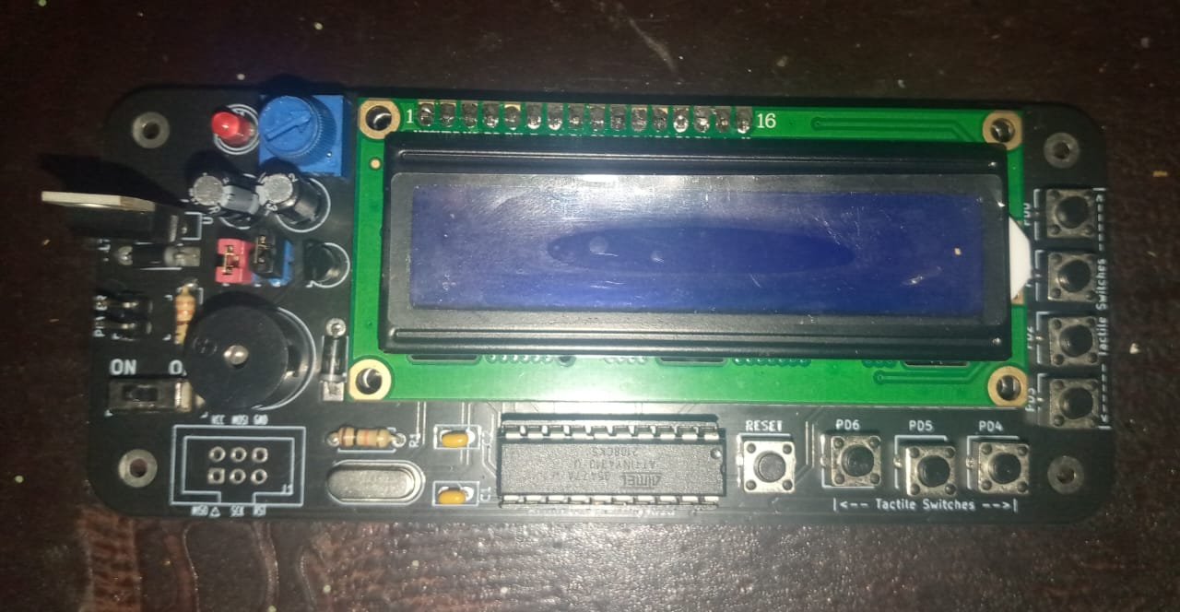
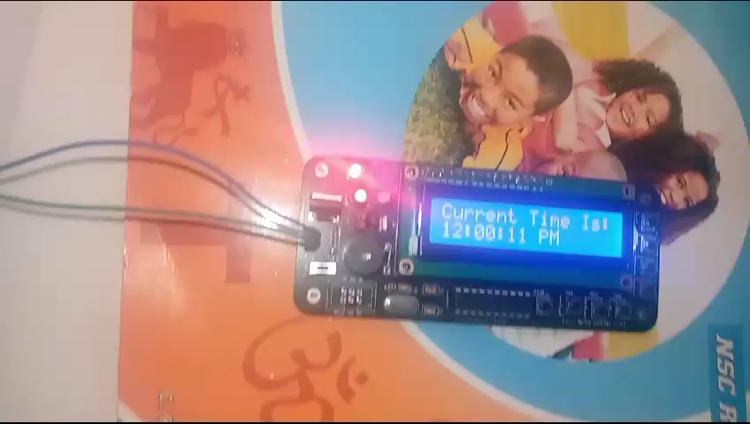
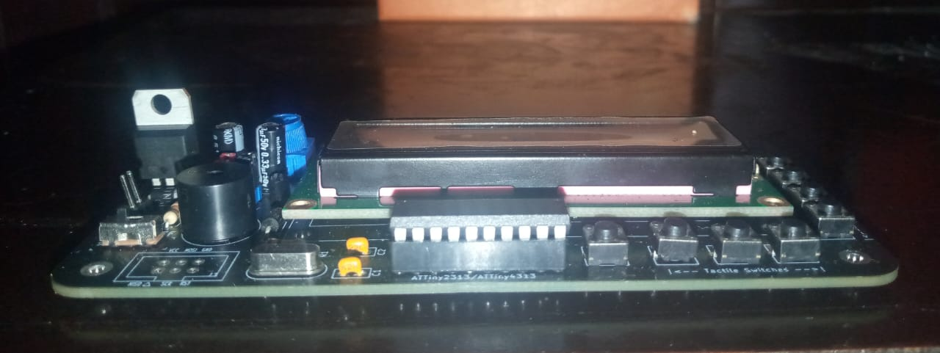
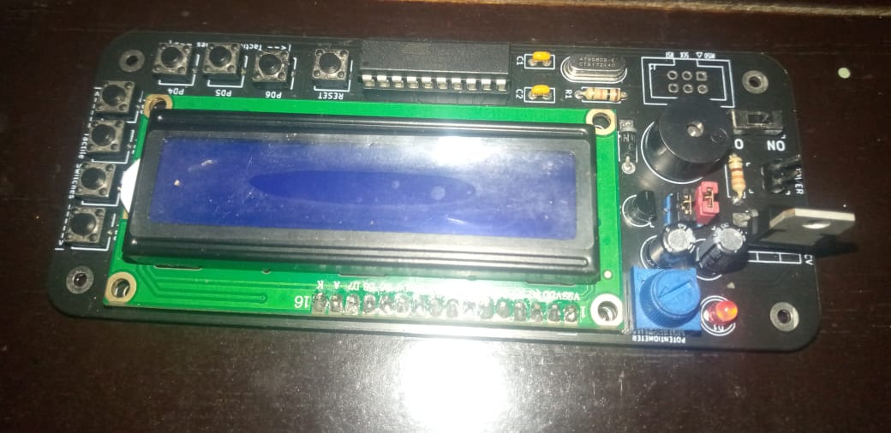
ATM Digital Timekeeper (ATM DTK)

Slide 5
ATM DTK Software
The program/blocks of code used to operate the digital clock.

Slide 6
Features and Essential Functions
Change Mode
Set Time
Set Alarm Time
Turn Off Buzzer
Snooze
Disable Alarm
Display Motivational Message

Slide 7
Change Mode
Change from mode 1 (twelve (12) hours mode) to mode 2 (twenty-four (24) hours mode) and vice versa.
Access by pressing PD1 on the Digital Clock PCB.
The 12 hours setting is mainly used by the general public/civilians and the 24 hours setting is mainly used be army personnel. This also makes the clock globally compatible.

Slide 8
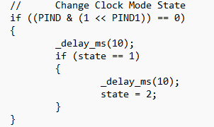
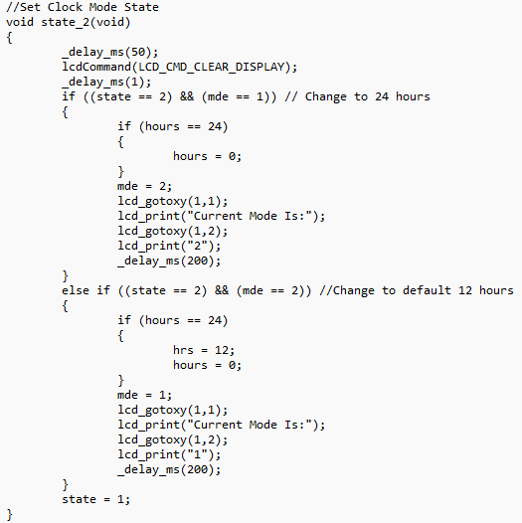

Slide 9
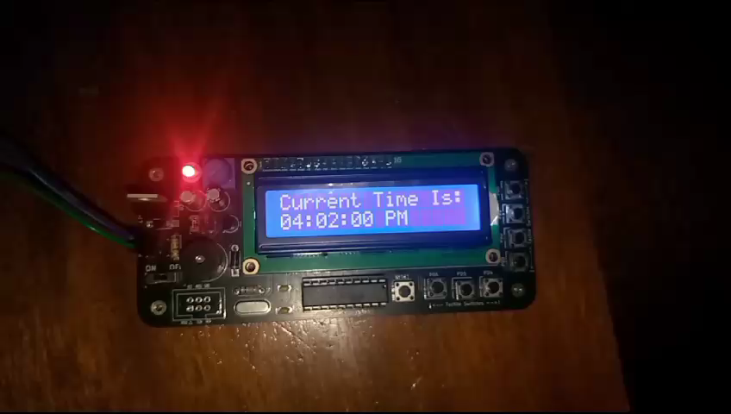
Video 1 showing demonstration of converting from mode 1 (12H) to mode 2 (24H) and vice versa

Slide 10
Set Time
Change the hours, minutes and seconds of the clock, whether in mode 1or mode 2.
Access by pressing PD2 on the Digital Clock PCB. Then, press PD4 to increment hours, PD5 to increment minutes or PD6 to increment seconds. Press PD0 to return to the normal clock state.
Allows users to set the correct hours, minutes and seconds of the clock so that it is able to display the accurately time.

Slide 11
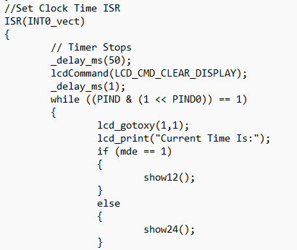
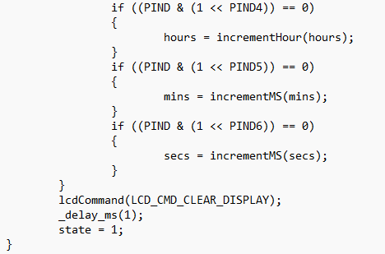

Slide 12
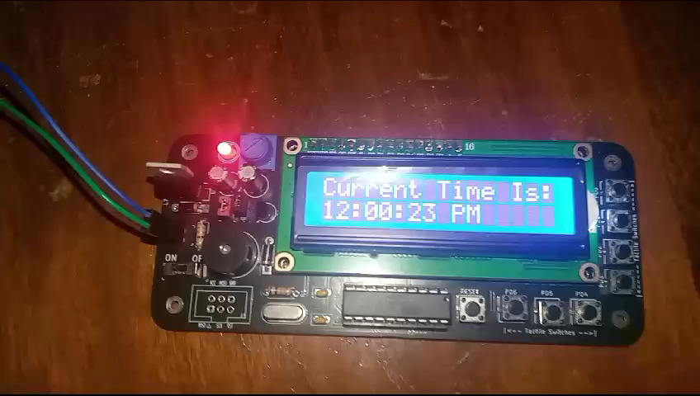
Video 2 showing demonstration of setting the time in mode 1 and mode 2

Slide 13
Set Alarm Time
Enables the alarm along with setting and storing the hours, minutes and seconds that they wish the alarm to go off on, whether in mode 1or mode 2.
Access by pressing PD3 on the Digital Clock PCB. Then, press PD4 to increment hours, PD5 to increment minutes or PD6 to increment seconds. Press PD0 to return to the normal clock state.
Facilitates efficient time management by serving as a reminder for significant occasions, assignments, or scheduled meetings.

Slide 14
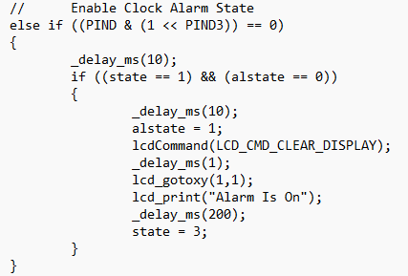
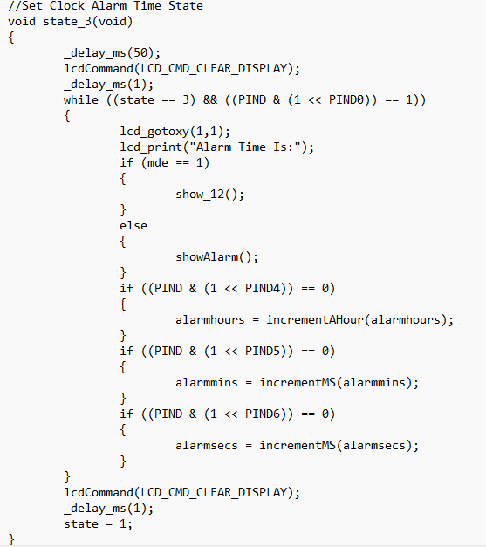

Slide 15
Turn Off Buzzer
Allows the user to disable the alarm and turn off the buzzer.
Access by pressing PD0 on the Digital Clock PCB.
Allows users to disable the alarm and turn off the buzzer whenever the user decides or wishes to disable the alarm and turn off the buzzer.

Slide 16
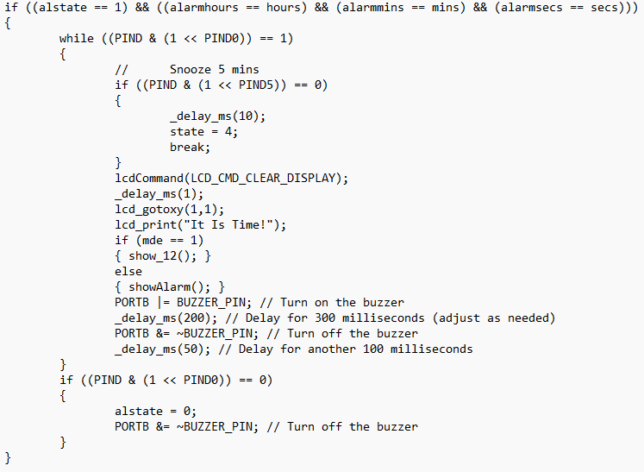

Slide 17
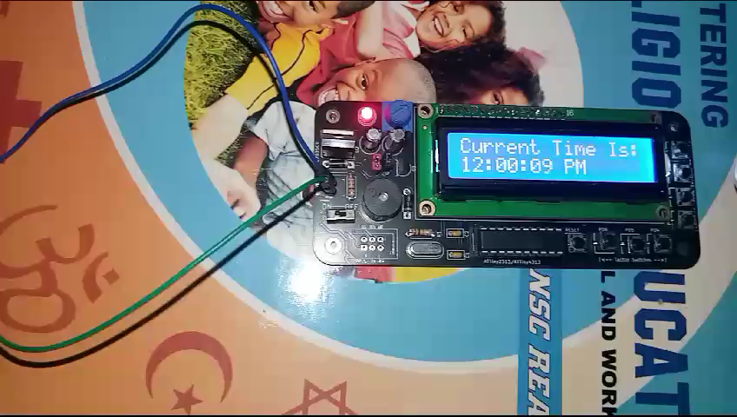
Video 3 showing demonstration of setting the alarm time and turning off the buzzer in mode 1 and mode 2

Slide 18
Snooze
Allows the user to keep the alarm enabled and add five minutes to their stored alarm time.
Access by pressing PD5 on the Digital Clock PCB.
Allows users to get a grace period of five minutes added to their original alarm time. This can be used to manage time more efficiently and make plans with five minutes leeway to make corrections to any error or to use as leisure time.

Slide 19
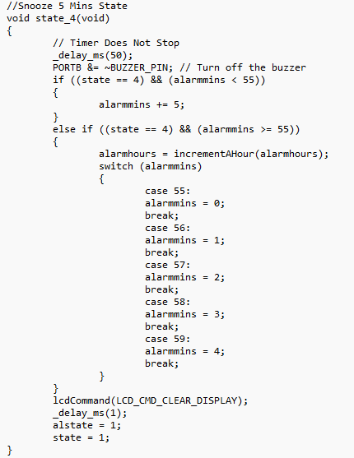

Slide 20
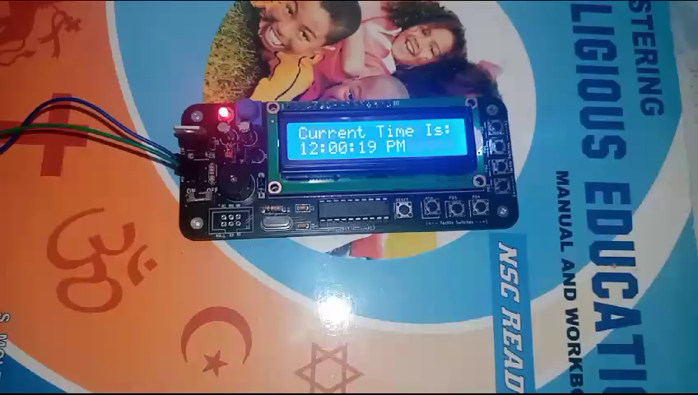
Video 4 showing demonstration of pressing snooze

Slide 21
Disable Alarm
Allows the user to disable the alarm after it has been enabled.
Access by pressing PD4 on the Digital Clock PCB.
Allows users to modify their schedule time in response to unforeseen changes in their plans. This adaptability is essential when an alarm is set for a time on which it is no longer needed.

Slide 22
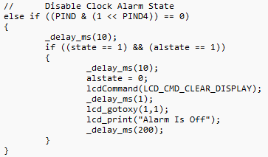

Slide 23
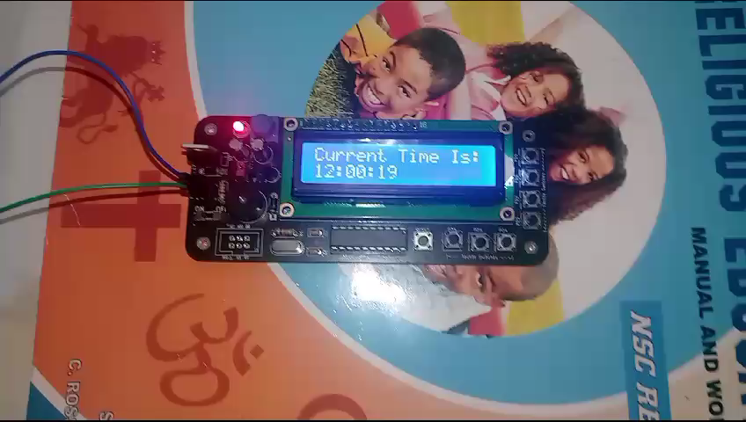
Video 5 showing demonstration of disabling the alarm

Slide 24
Display Motivational Message
Allows the user to view the motivation message “JUST DO IT!!!” and have a source of inspiration.
This feature is accessed by pressing the button labeled “PD6” on the Digital Clock PCB.
This is advantageous because this functionality can provide some inspiration to the user. This would also add to the digital clock’s unique attribute.

Slide 25
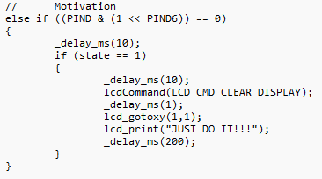

Slide 26
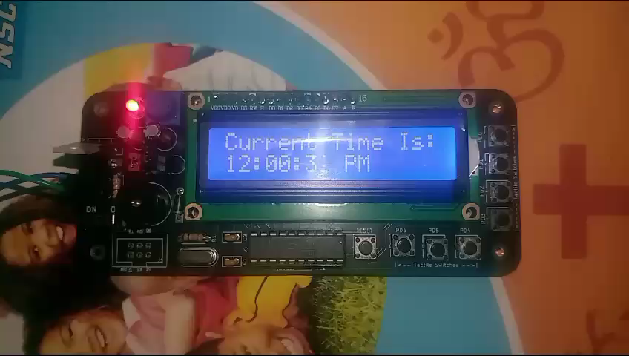
Video 6 showing demonstration of displaying the motivational message

Slide 27
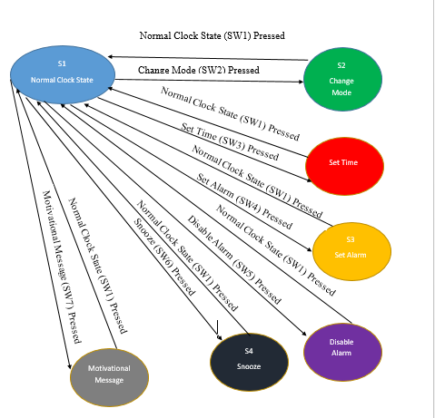
Software State Diagram

Slide 28
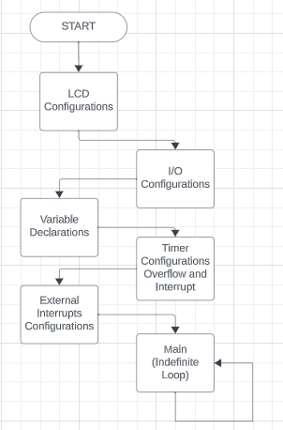
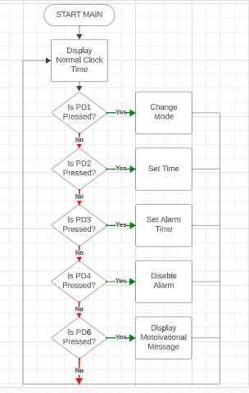
Flow chart
Figure 1 showing general operations of ATM DTK | Figure 2 showing logical operations of ATM DTK

Slide 29
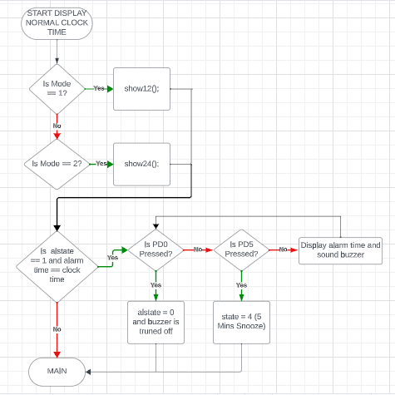
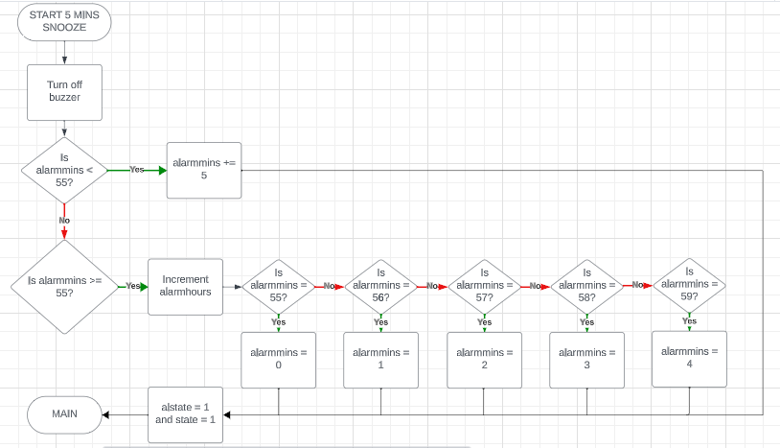
Figure 3 showing the “display normal clock time” | Figure 4 showing the “5 Mins Snooze” process
process |

Slide 30
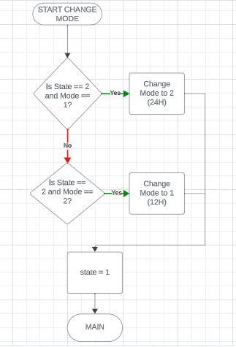
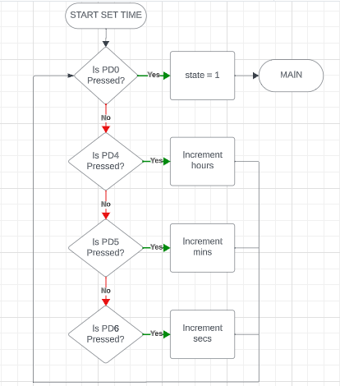
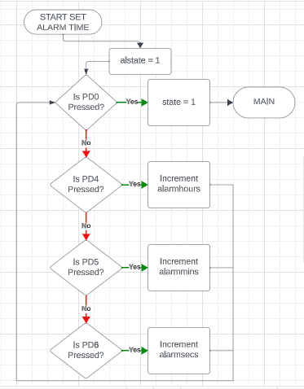
Figure 5 showing the | Figure 6 showing the | Figure 7 showing the
“change mode” process | “set time” process | “set alarm time” process

Slide 31
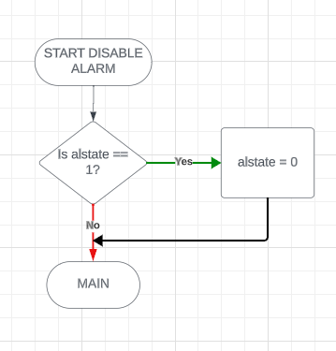
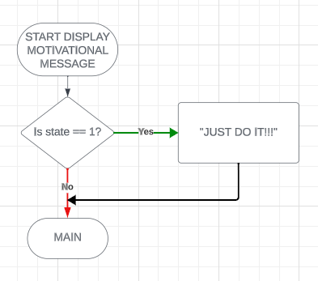
Figure 8 showing the “disable alarm” process | Figure 9 showing the “display motivational | message” process

Slide 32
ATM DTK Hardware
The physical devices, machines, wiring, and other electronic components

Slide 33
Hardware Block Diagram
Block diagram for the digital clock in which an LCD serves as the display, a microcontroller serves as the brain, and buttons serve as input devices.
Block diagram also displays the quantity of I/O lines required to connect to the microcontroller and the power supply required for operation.
The Digital Clock Hardware Block Diagram was utilized to identify the precise parts that will be connected to and interacted with the microcontroller.

Slide 34
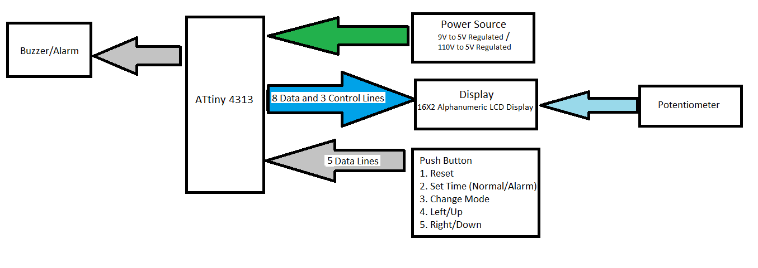
Push Buttons
Reset
Display Normal Clock State
Change Mode
Set Time
Set Alarm Time
Disable Alarm/Increment Hours
Snooze/ Increment Minutes
Motivational Message/Increment Seconds
8 Data Lines

Slide 35
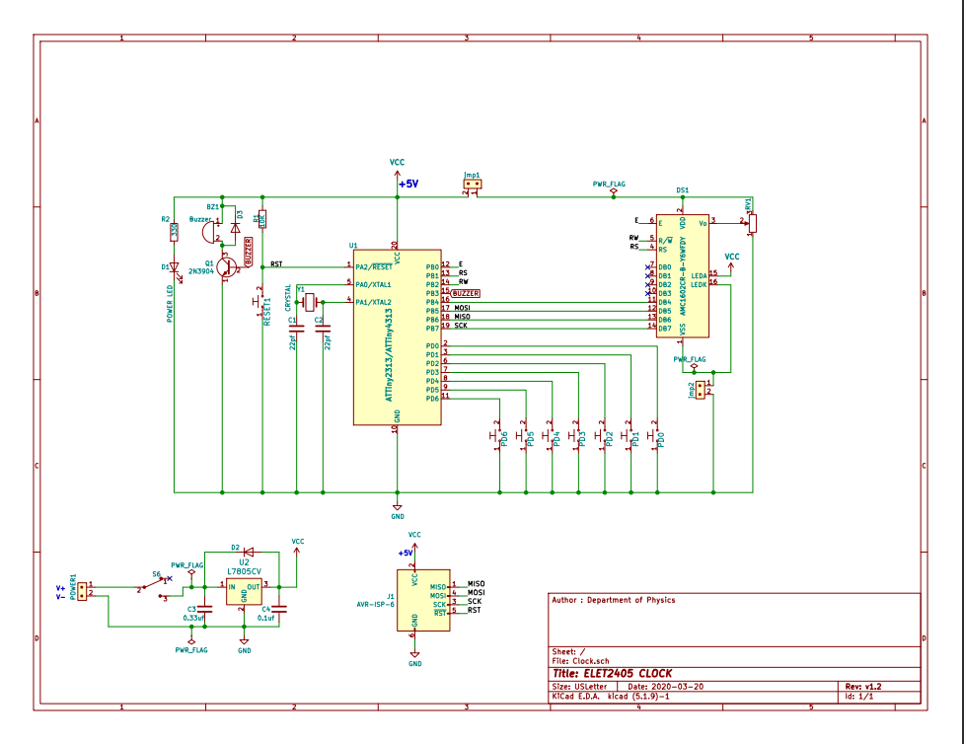
ATM DTK Schematic Diagram

Slide 36
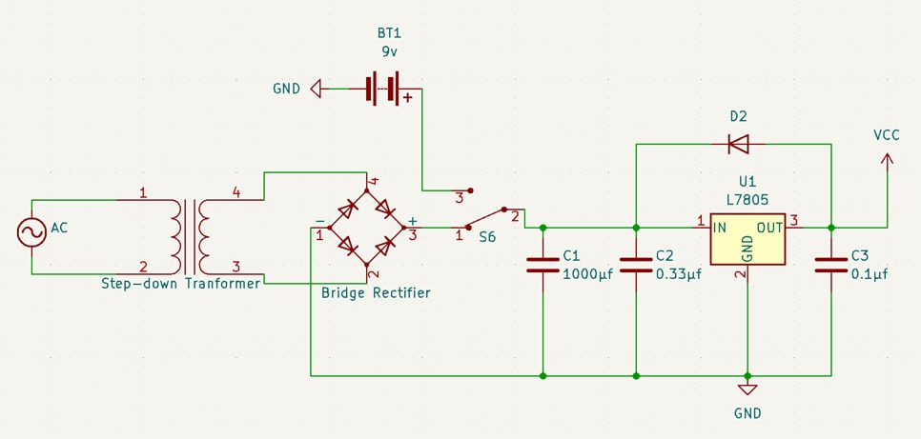
Power Supply Schematic Diagram

Slide 37
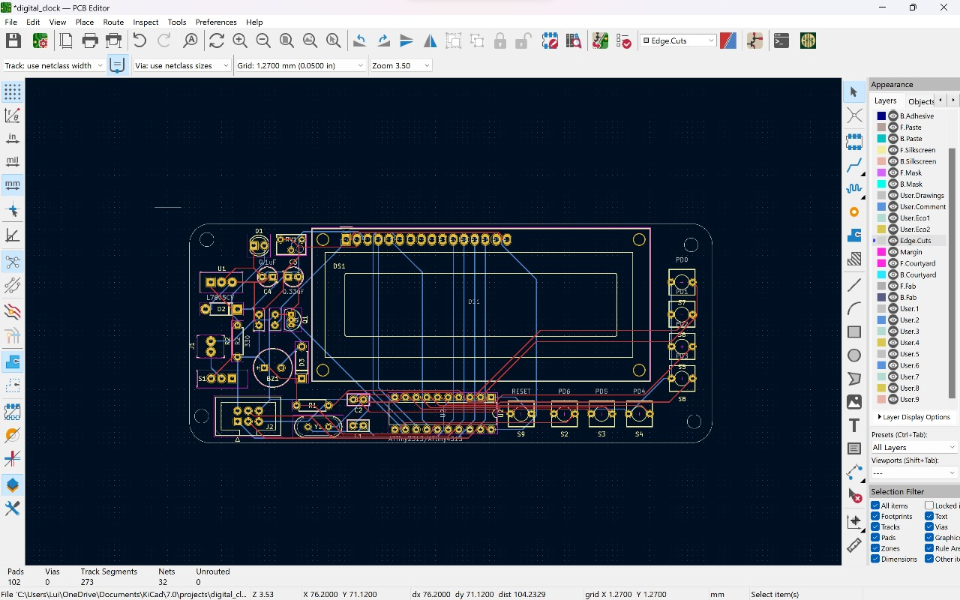
PCB Layout

Slide 38
Components Cost List
Table 1 – Equipment and Components Required for Digital Clock Project
Items | Quantity | Price Per Unit ($)
Pololu AVR USB programmer or any other hardware programmer capable of programming 8-bits AVR microcontrollers. | 1 | 3,500.00
Computer loaded with Microchip Studio 7 and KiCad. | 1
Soldering Iron | 1 | 500.00
Components | ATtiny2313A or ATtiny4313 AVR Microcontroller | 1 | 450.00
 | 16x2 Alphanumeric LCD | 1 | 1,250.00
 | L7805CV (+5V) Voltage regulator | 1 | 100.00
 | 9V Battery | 1 | 738.83
 | Red LED | 1 | 50.00
 | Push Button Switch | 8 | 320.00
 | 0.33 µF capacitor | 1 | 75.00
 | 0.1 µF capacitor | 1 | 75.00
 | 22 pF capacitor | 2 | 75.00
 | 330 Ω resistor | 1 | 30.00
Components | 10k Ω resistor | 1 | 30.00
 | Quartz Crystal Oscillator , between ( 8 – 20 MHz) | 1 | 100.00
 | Sliding Switch(3 Pin) | 1 | 200.00
 | 10kΩ Potentiometer | 1 | 200.00
 | 1N4007 Diode | 3 | 75.00
 | 20pin DIP Socket | 1 | 100.00
 | 2 Pin Header (Male) | 1
 | 16 Pin Header (Male) | 1 | 200.00
 | 16 Pin Header (Female) | 1 | 200.00
 | Buzzer | 1 | 200.00
 | 2N3904 Transistor | 1 | 75.00
 | Solder Wire | 3ft | 500.00
 | PCB Clock Board | 1 | 500.00

Slide 39
Why is ATM DTK The Best?
Why choose ATM DTK?

Slide 40
The ATM DTK’s Beauty
The ATM DTK is a compact, lightweight, handheld, portable gadget.
The ATM DTK’s unique attribute of displaying a motivational message.
The ATM DTK operated using the ATtiny4313 microcontroller, a dependable and programmable computational device, which shows the time with a one second precision to a 16x2 Alphanumeric LCD display.

Slide 41



Challenges Faced

Slide 42


But is your clock perfect?

Slide 43

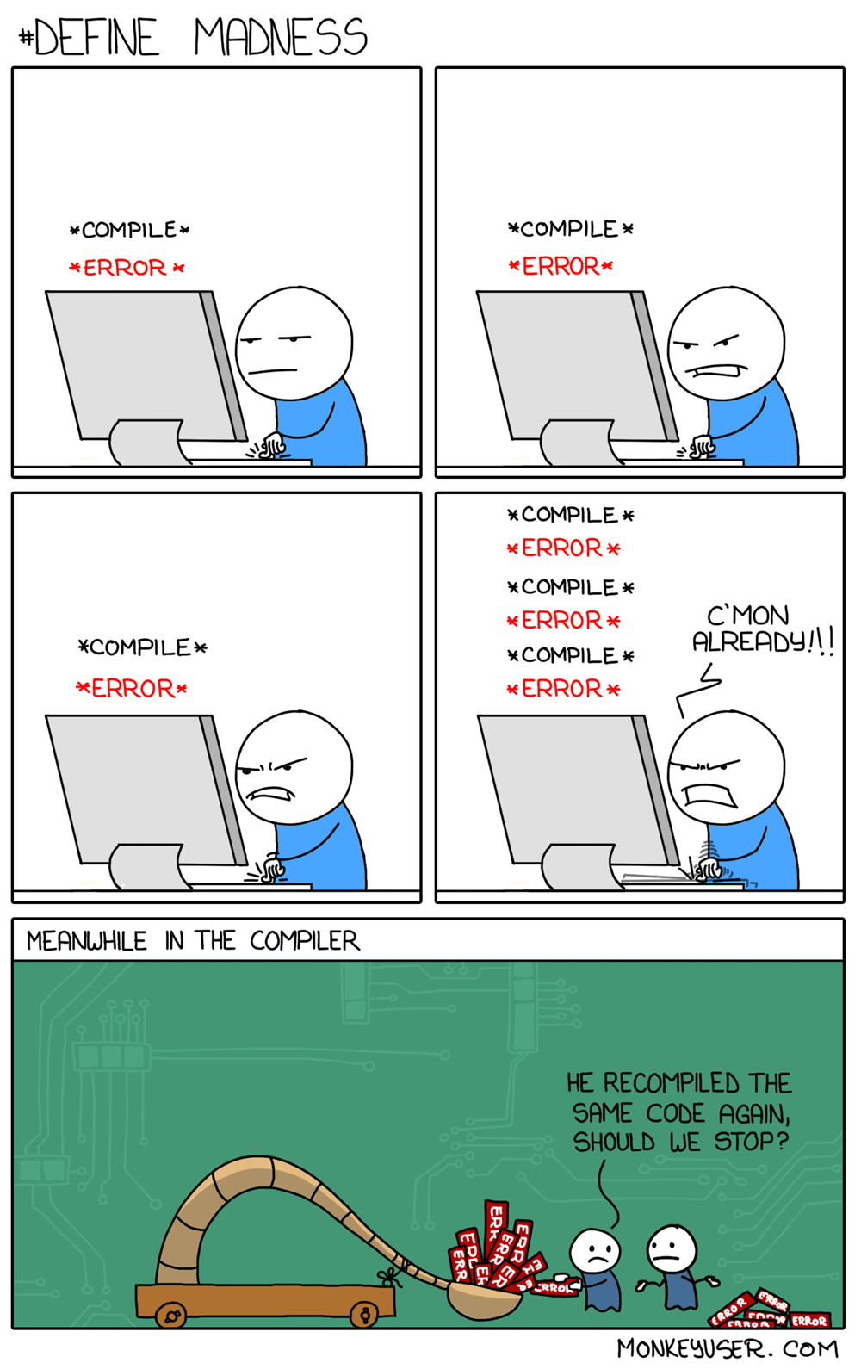

Slide 44
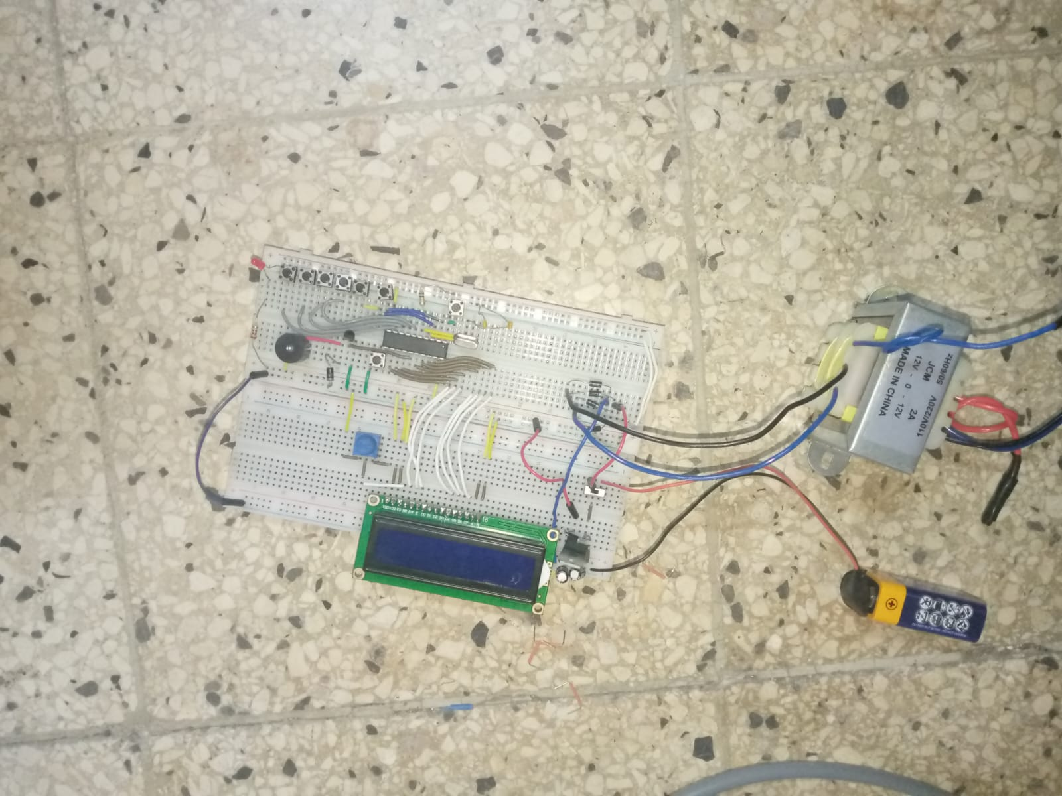

Slide 45
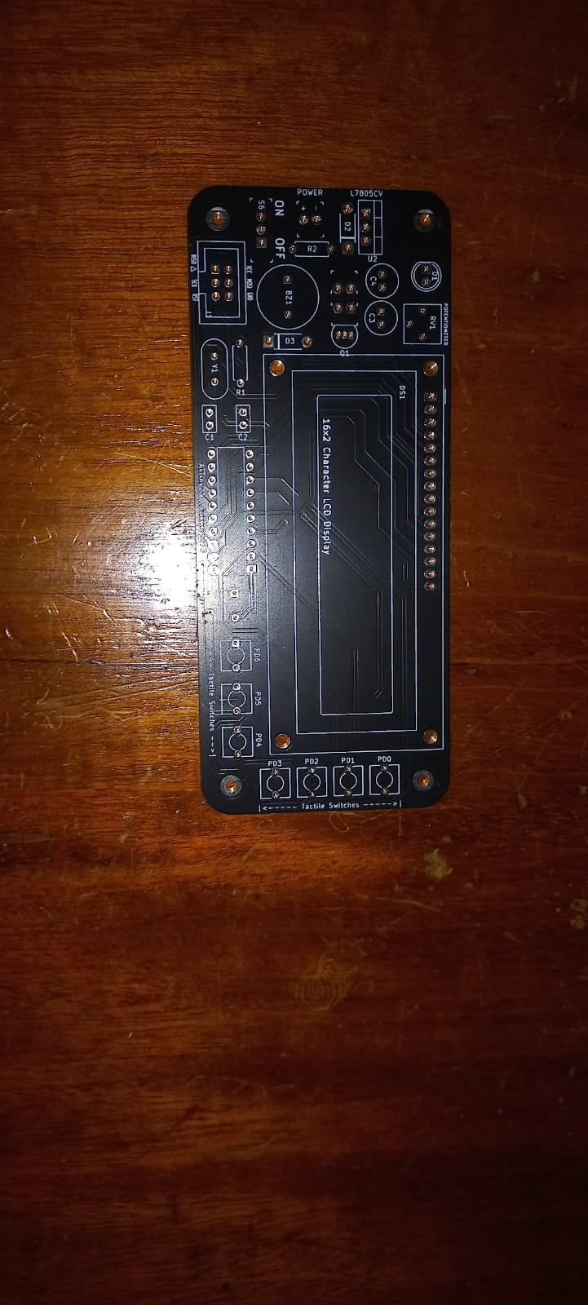
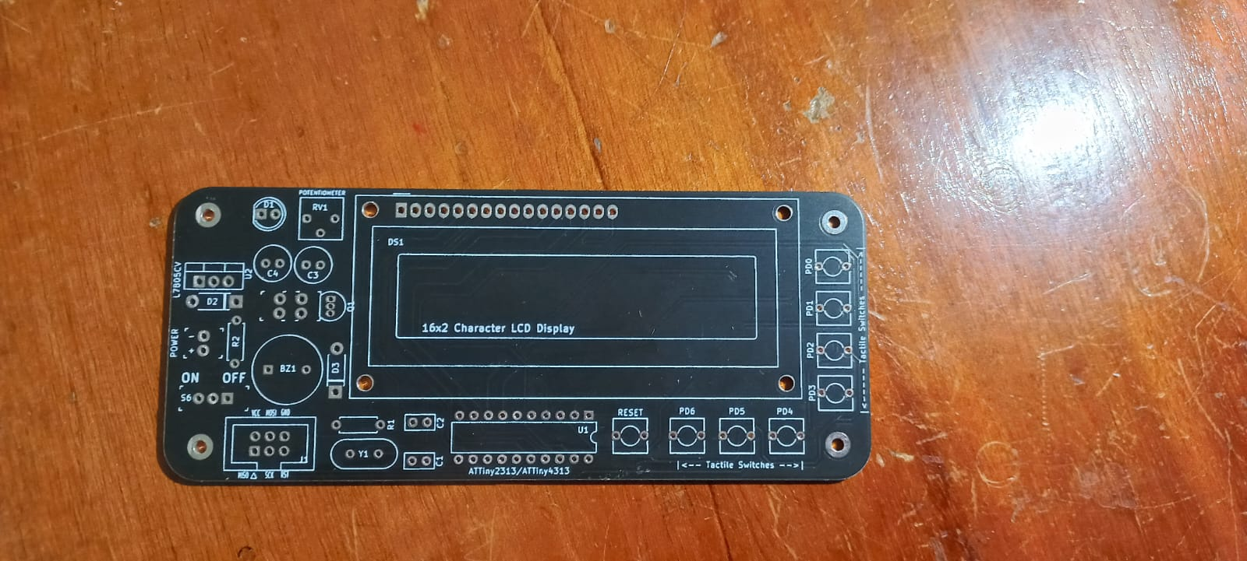

Slide 46
References
ELET2405 Experiment 3 (2023)
ELET2405 Digital Clock Project Report (2023)
ELET2405 Information Sheet

Slide 47


Thank you for listening!!!
The ATM DTK Keep Time In The Best Way!!!

